Slide 1

Towards Sustainable Aquaculture: An IoT-Driven Indoor Fish Farming System
Paper ID 210
Md. Ayenul Azim , Indrojit Sarkar, Md. Ashiqul Haider Chowdhury, Fazle Rabbi ,
Email: {mdayenulazim.jahin, indro.ij, aupurbo392000 , rabbifazle38}@gmail.com
Department of Electrical and Electronic Engineering, Bangladesh University of Engineering and Technology, Dhaka1205, Bangladesh

Slide 2
Outline
Introduction
Literature Review
Circuit Diagram
Key Features
System Performance Evaluation with Tilapia Species
Cost Calculation
Future Direction
Conclusion

Slide 3
Introduction
Importance of Aquaculture
Food Security
Economic Contribution
Sustainability
Challenges in The Fishery Industry
Labor Supply
Outdated Methods
Innovative IoT-Based Indoor Fish Farming
Real-Time Monitoring
User Friendly Application
Automation Food and Chemical Supply

Slide 4
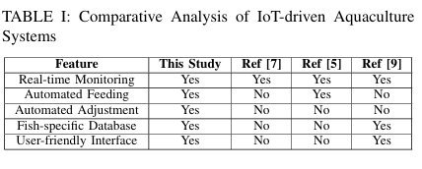
Literature Review
[7] P. Veeralakshmi, S. Sowmya, K. N. Kannan, S. Anbu, and G. Ayyappan, “An efficient and smart iot based pisciculture for developing countries,” in AIP Conference Proceedings, vol. 2393, no. 1. AIP Publishing, 2022.
[5] Y. Wu, Y. Duan, Y. Wei, D. An, and J. Liu, “Application of intelligent and unmanned equipment in aquaculture: A review,” Computers and Electronics in Agriculture, vol. 199, p. 107201, 2022.
[9] L. K. Oliveira, W. Wasielesky Jr, and M. B. Tesser, “Fish culture in biofloc technology (bft): Insights on stocking density carbon sources, c/n ratio, fish nutrition and health,” Aquaculture and Fisheries, 2022.

Slide 5
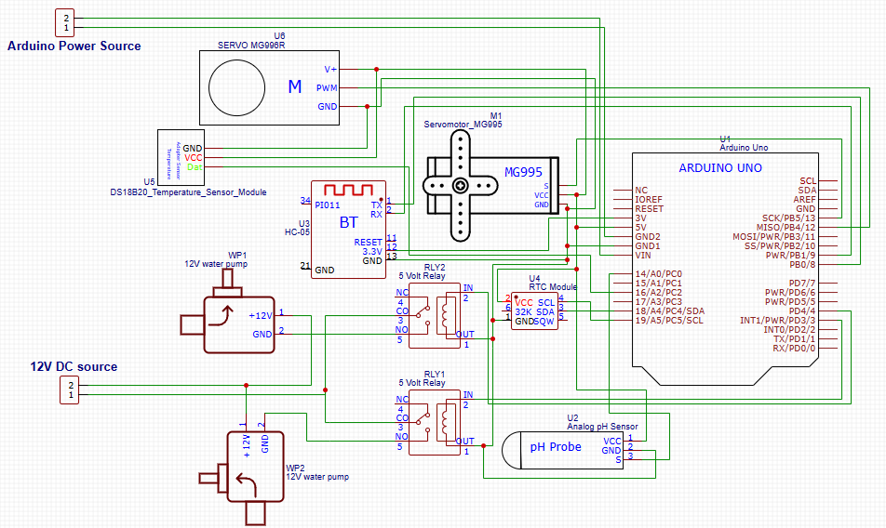
Circuit Diagram
Fig: Circuit diagram

Slide 6
Key Features
pH Control and Adjustment
Temperature Regulation and Water Circulation
Automated Feeding
Mobile Application

Slide 7
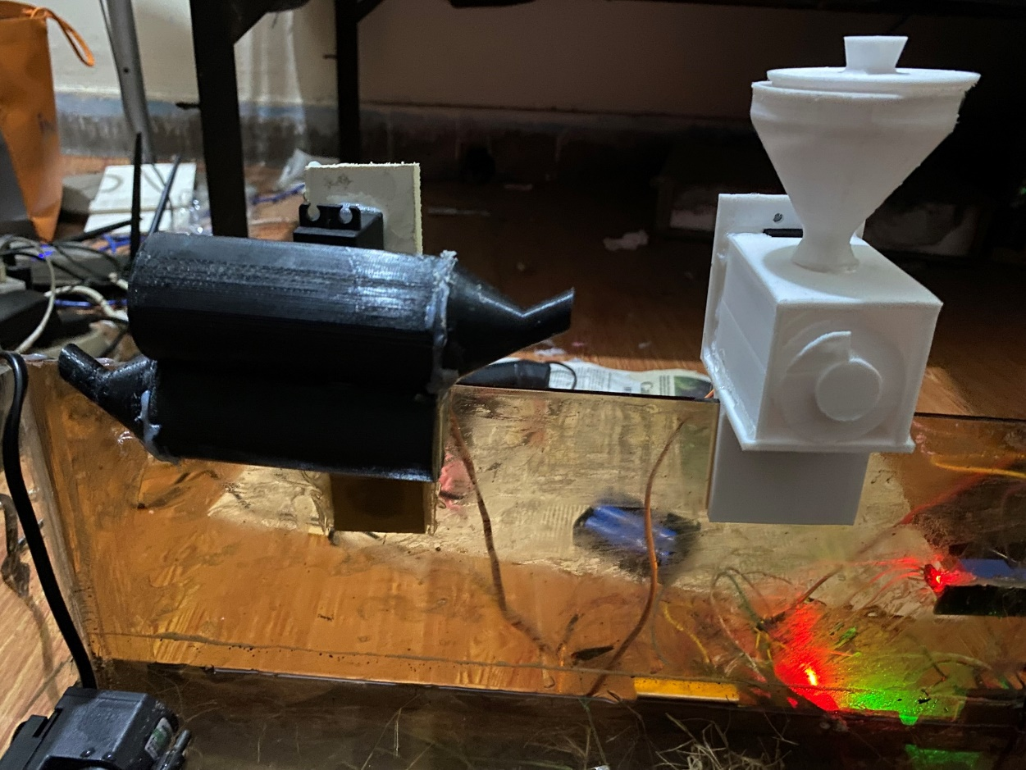
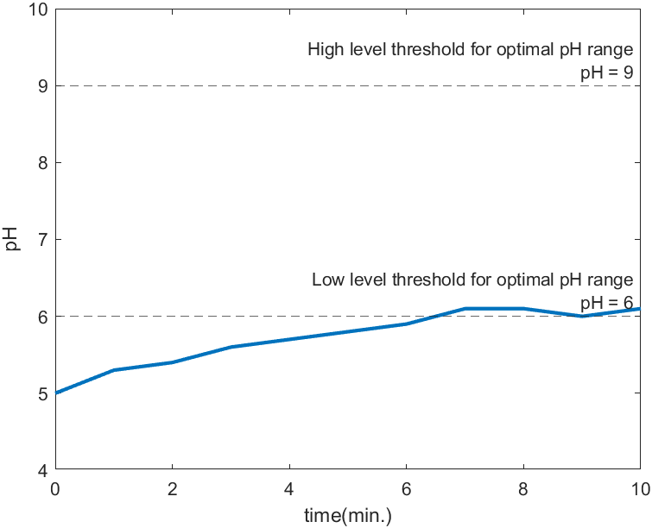
pH Control and Adjustment
A dual-container system automatically feeds fish three times a day. One container (black) holds acid and base (citric acid and NaHCO3) for controlled release, while the other (white) stores fish food.
The figure shows a pH versus time plot in a controlled test. Initially set to pH 5, the system uses an MG996 stepper motor to add NaHCO₃ when pH drops below the optimal 69 range, stopping once the pH is restored.

Slide 8
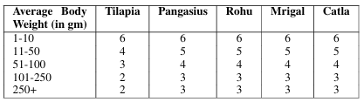
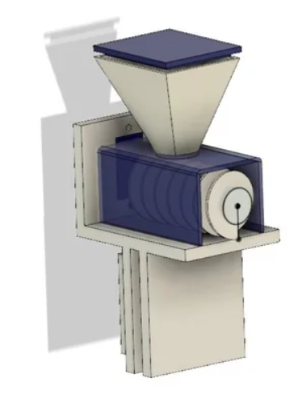


Automated Feeding
MG995 motor
Feeding three times a day
Customizable Feeding settings
Precise Food Dispensing
TABLE II: Average Body Weight vs % Feed
Used formulas:
The figure shows the designed structure for 3D printing in Fusion360

Slide 9
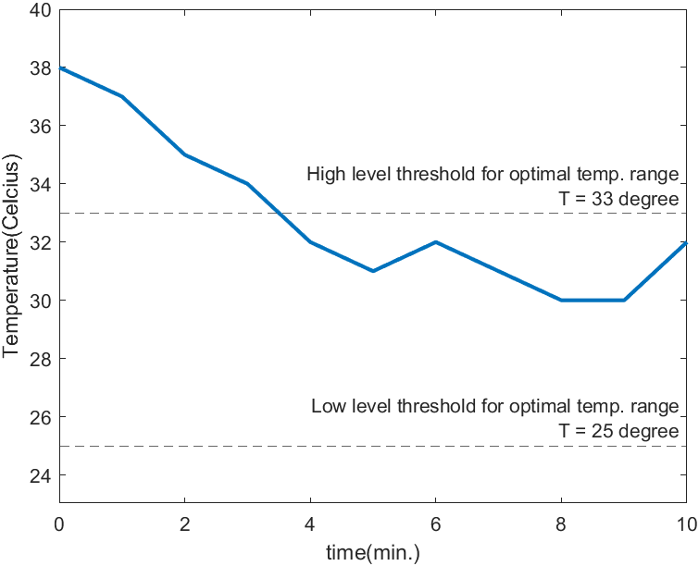
Temperature Regulation and Water Circulation
Temperature Control System:
A waterproof DS18B20 sensor monitors and maintains the water temperature within a target range of 25 to 33°C. If the temperature deviates, a submersible pump adjusts it by drawing water from a reserve source.
Water Quality Management:
Two submersible pumps manage daily water replacement, ensuring consistent water quality and oxygen levels in the tank.
The figure displays a temperature vs. time plot for a fish tank. The submersible pump automatically adds cooler water to maintain a 25 to 33°C range.

Slide 10
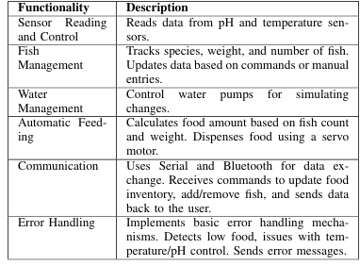
Functionality Overview
Table: Functionality Overview of the Arduino Fish Tank Control Code
Arduino code consist six functionality:
Sensor Reading and Control
Fish Management
Water Management
Automatic Feeding
Communication
Error Handling

Slide 11
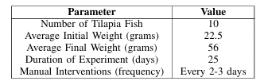
System Performance Evaluation
Case: 10 tilapia fish, each averaging 22.5 grams
Table: Summary of Testing Results for Tilapia Species
Observations:
Proper Growth Indication
Zero death
Proper pH control and food supply

Slide 12
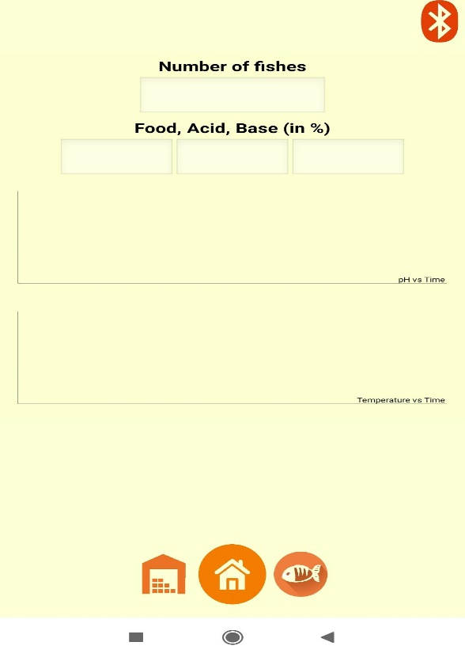
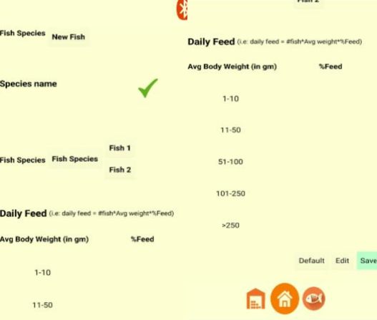
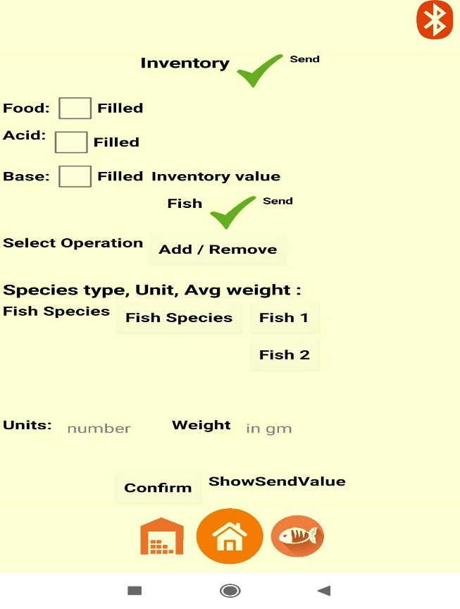
Mobile App Implementation
HOMESCREEN
DATABASE SCREEN
INVENTORY SCREEN
The Homepage serves as a central dashboard, showing realtime fish population, resource levels, and graphs of pH and temperature trends for a comprehensive view of the aquatic environment.
The Database screen allows users to select a fish species and its feeding data (default or custom) based on average weight. It also supports the addition and customization of data for two additional fish species.
The figure illustrates inventory input in the fish farm system. Checking a box during food or chemical refills automatically updates their levels to 100%, ensuring accurate resource monitoring.

Slide 13
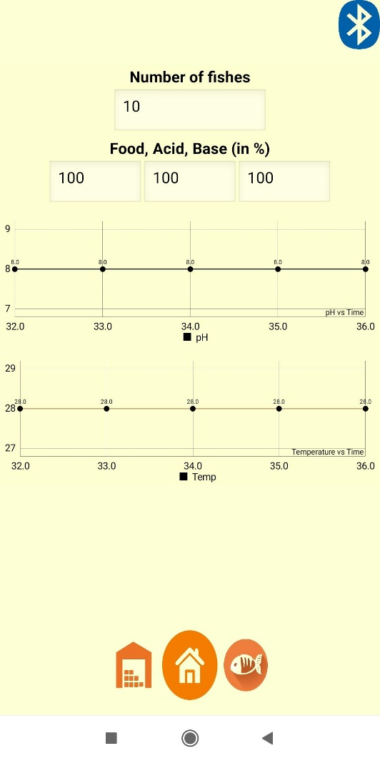
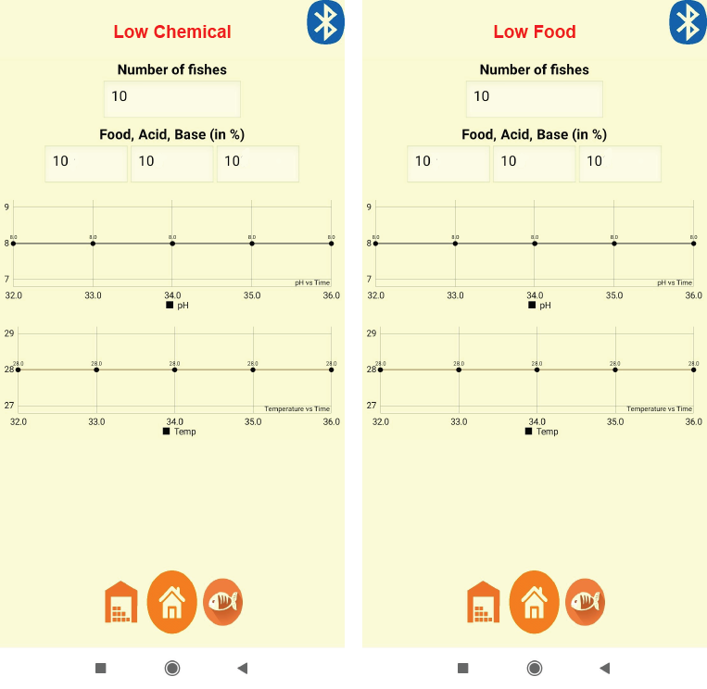
Mobile App Implementation
Operational Interface
Current Fish Population
Resource Levels
pH and Temperature value
Low resource level
Alert triggered

Slide 14
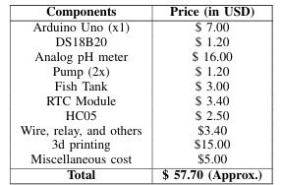
Cost Calculation
Table: Approximate cost breakdown of the developed prototype. Costs may vary depending on location and quantity.

Slide 15
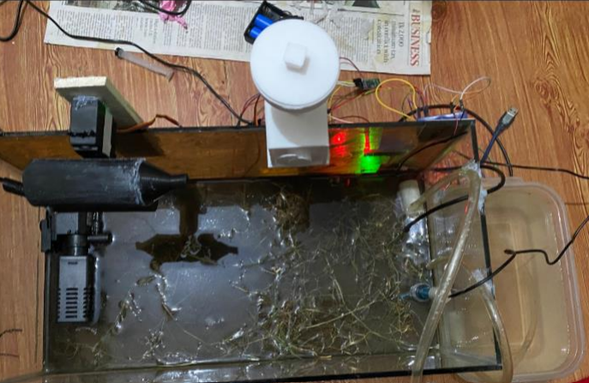
Final Prototype
IoT-Based Approach
Enhanced Efficiency
Real Time Monitoring
Intelligent control
PEEIACON 2024
International Conference on Power, Electrical, Electronics and Industrial Applications (PEEIACON) 2024
IoT-Driven Indoor Fish Farming System

Slide 16
Future Direction
Future Directions:
Improve alert system response times.
Integrate analytics and machine learning for optimized control.
Explore block-chain for better traceability and sustainability.
Data Availability
All codes and materials are available in github
Email for future collaboration.
PEEIACON 2024
International Conference on Power, Electrical, Electronics and Industrial Applications (PEEIACON) 2024
IoT-Driven Indoor Fish Farming System

Slide 17
Conclusion
Advanced IoT-Based System: Enhances fish farming with automation and real-time monitoring.
User-Friendly Mobile App: Manages feeding, pH, temperature, and other parameters seamlessly.
Key Contributions:
Automated Feeding: Accurate nutrition delivery with minimal variations.
pH Regulation: Maintains optimal water quality with ±0.2 units deviation.
Temperature Control: Keeps water within 25-33°C, with ±1°C deviation.
User Notifications: Alerts users to critical situations, though occasional delays noted.

Slide 18
Thank you !
Feel free to ask questions about the presentation !

